Slide 1

Olcay IŞIK B1705.090032
Internet Programming Report

Slide 2
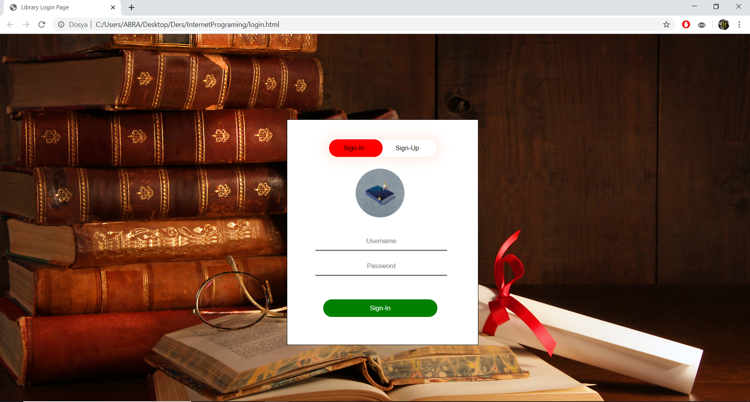
Login Page Sign-In Part

Slide 3
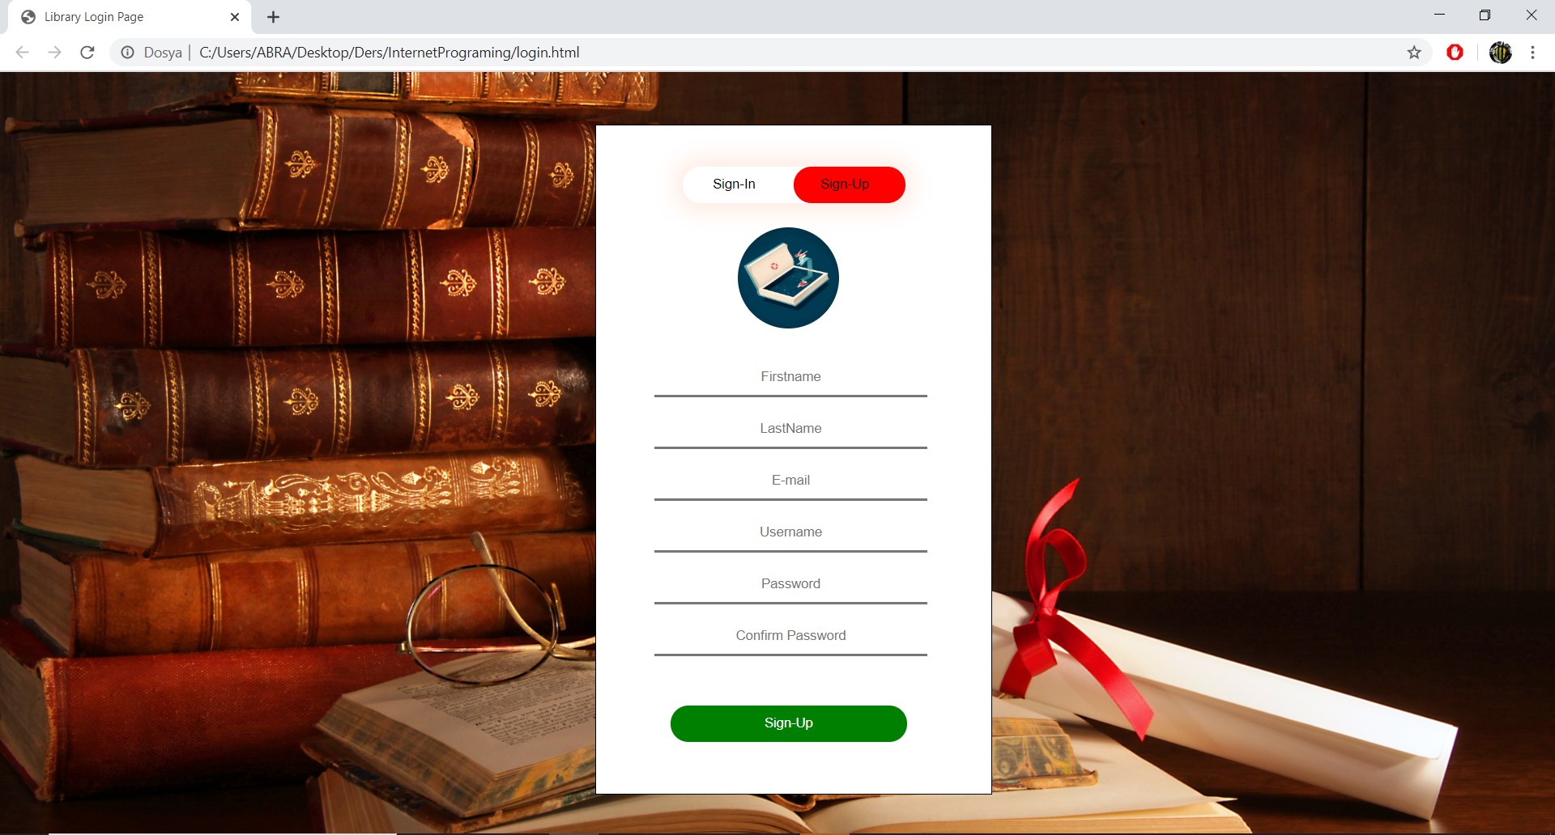
Login Page Sign-Up Part

Slide 4
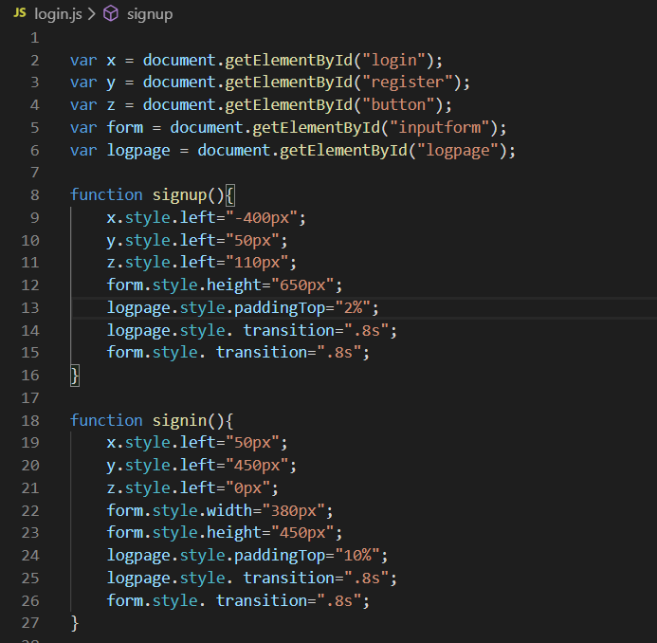
JS Code for Login Form

Slide 5
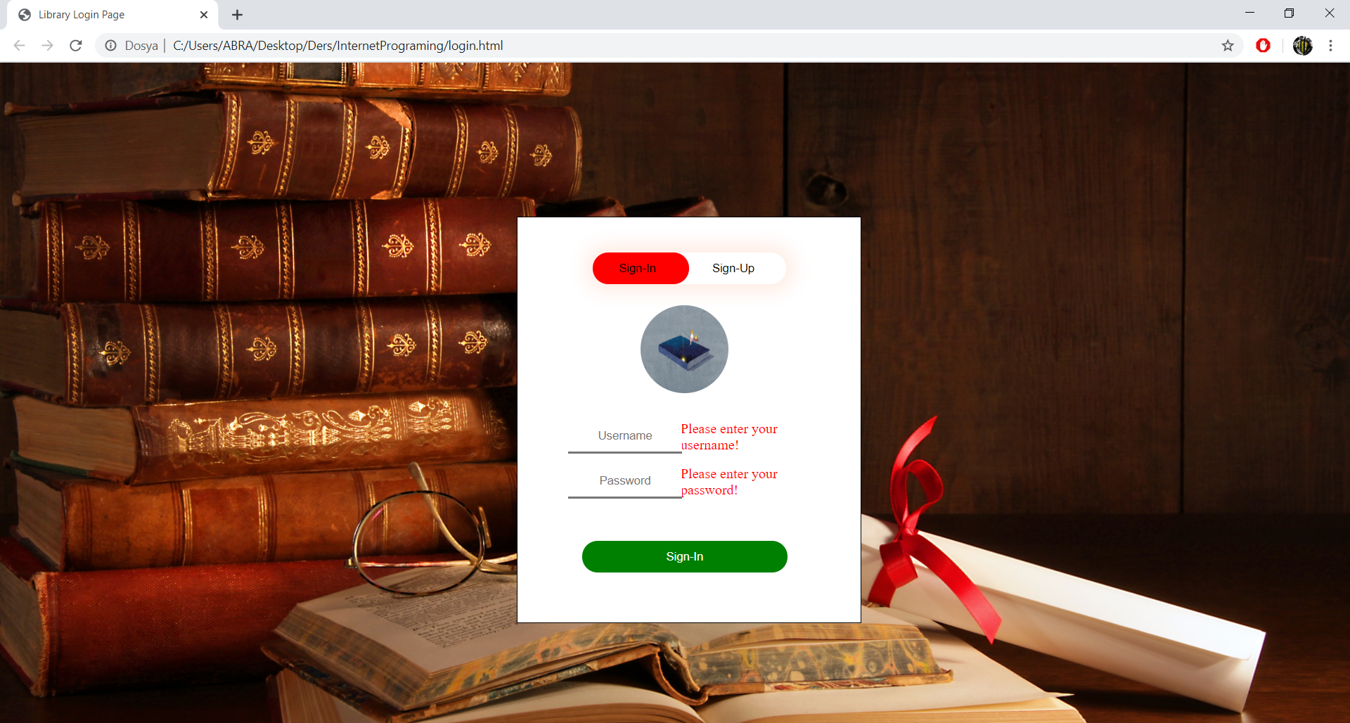
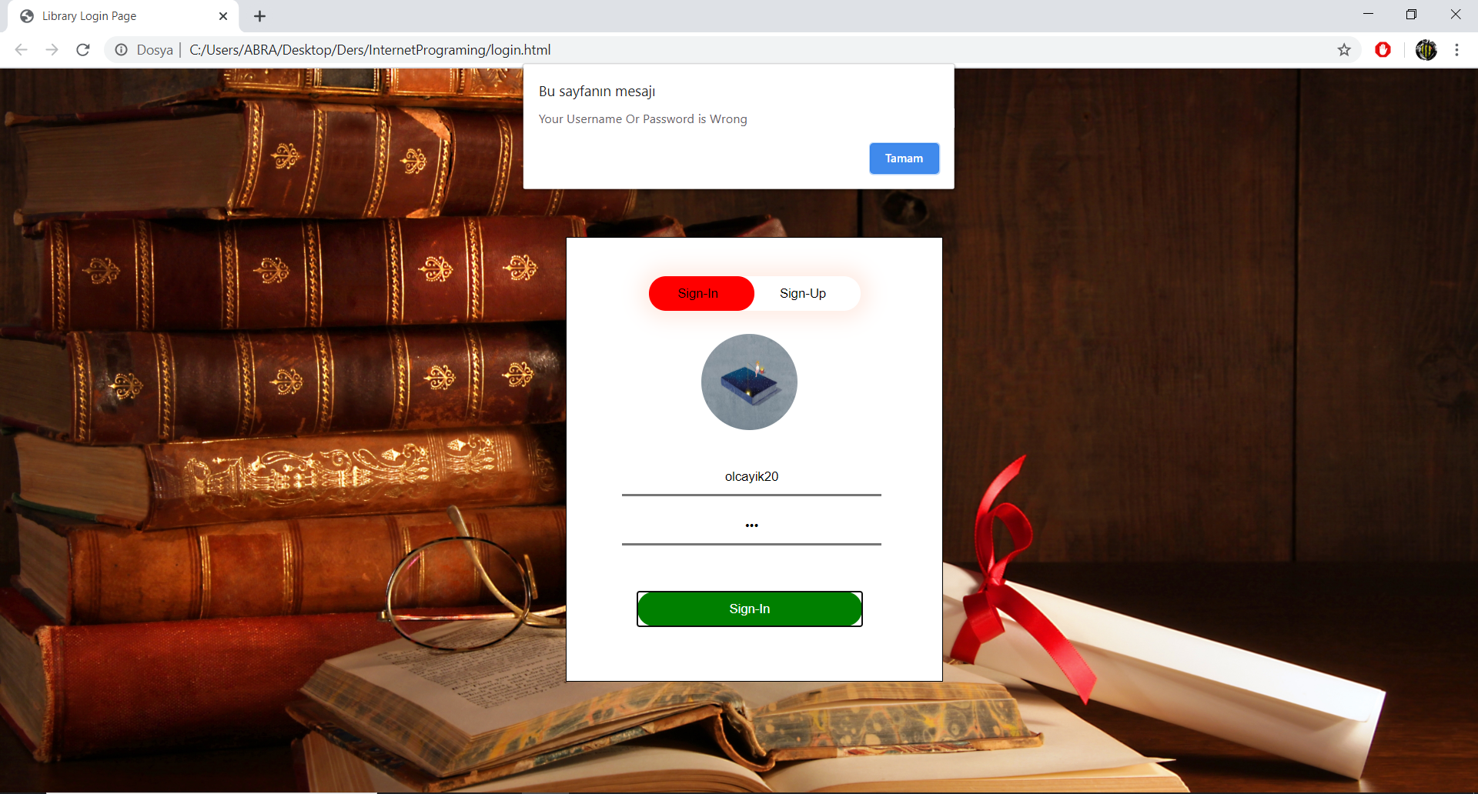
Sign-In Validation Controls

Slide 6

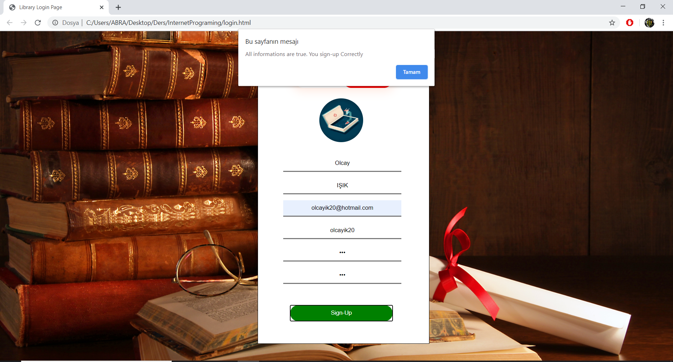
Sign-Up Validation Controls

Slide 7
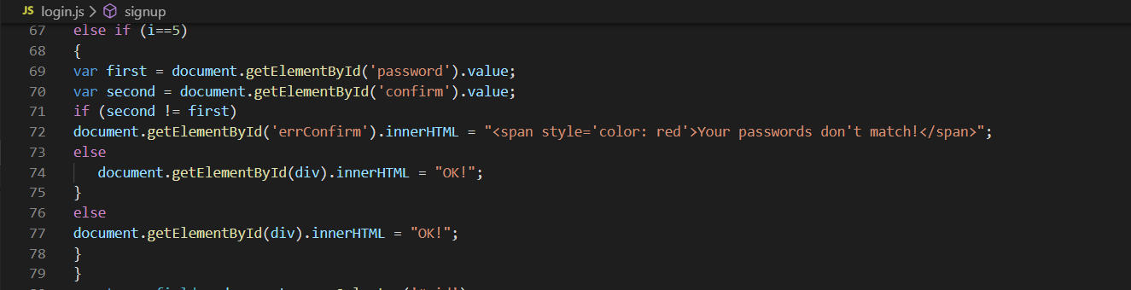
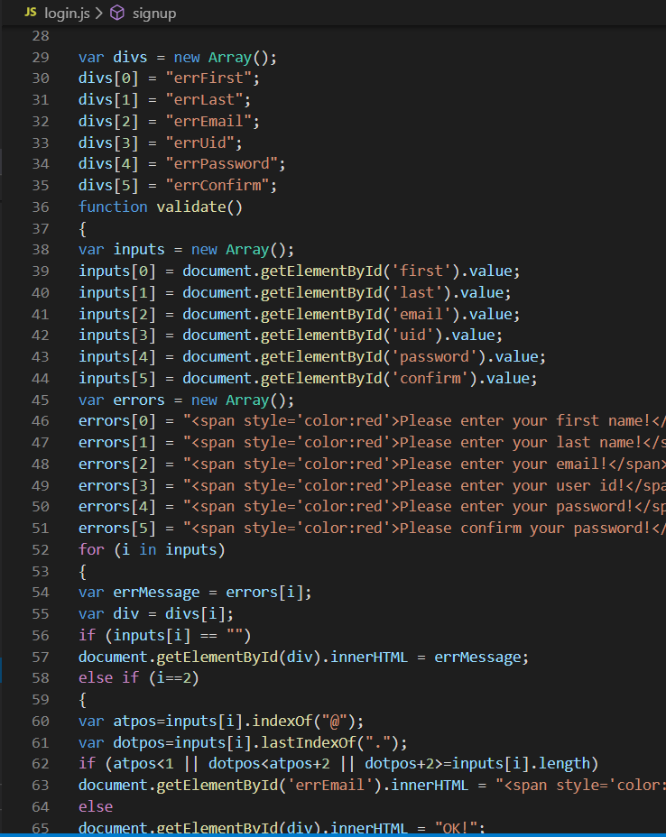
JS CODE
LOGIN FORM VALIDATION

Slide 8
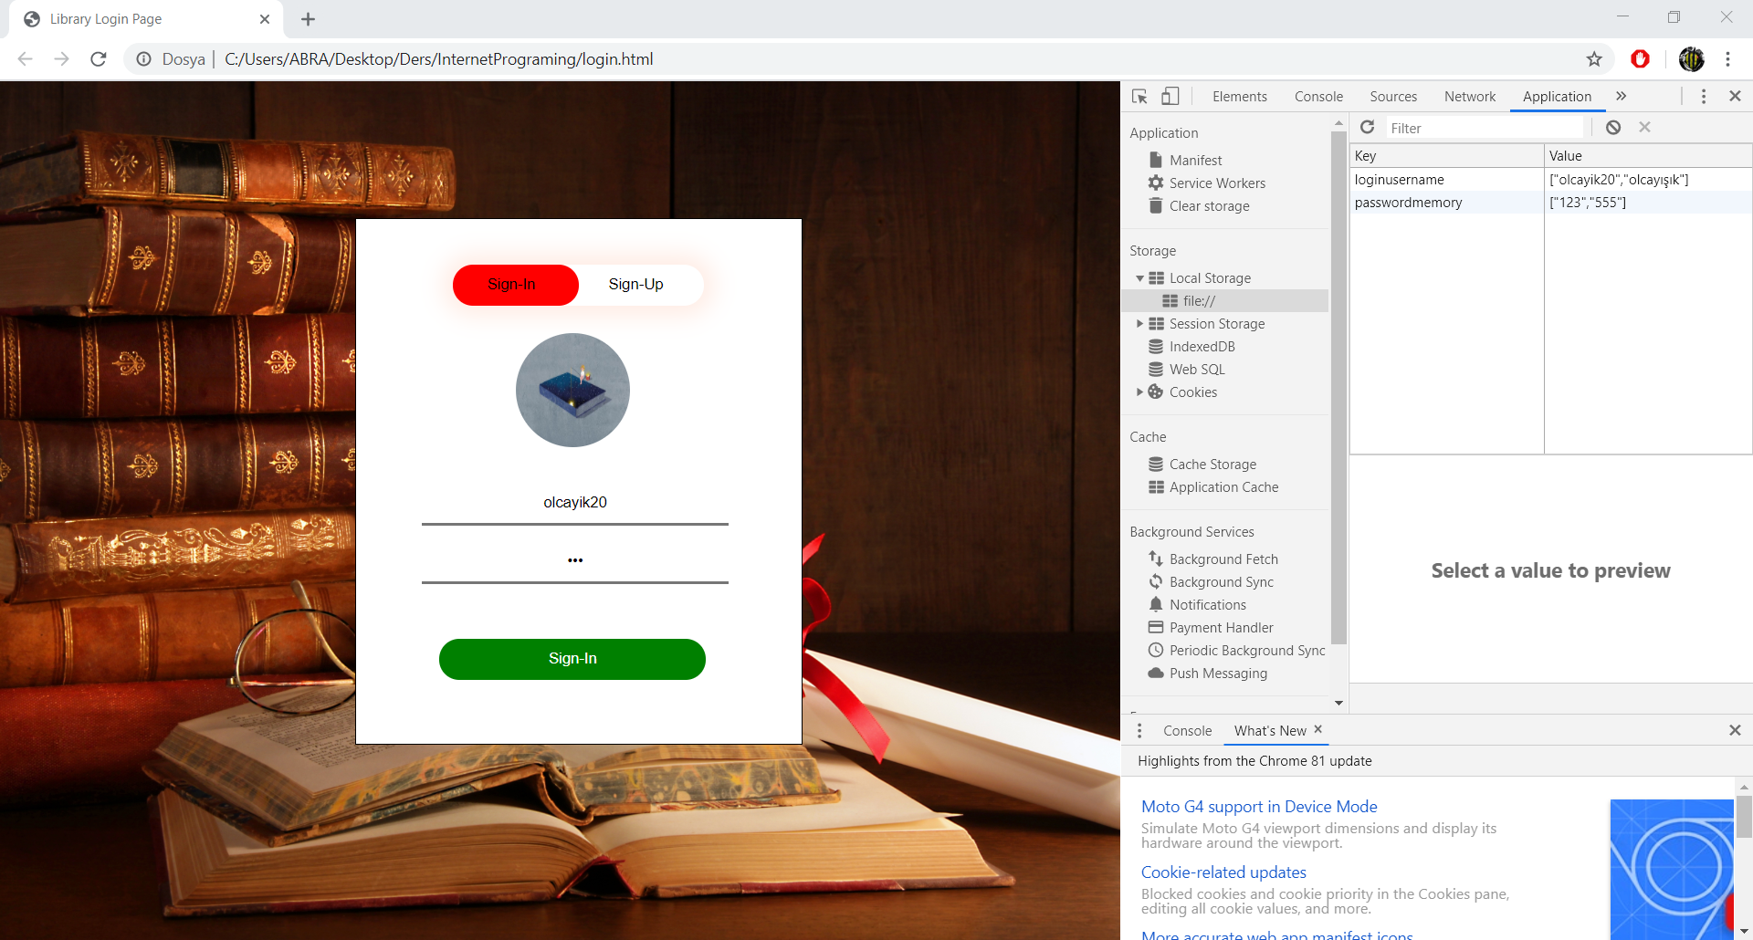
Information About Login Page
I use Local Storage for storing information. I am putting the informations in the array every time the system is turned on. And I do the validation with these arrays.That way I don’t lose the user information while the system turned off.

Slide 9
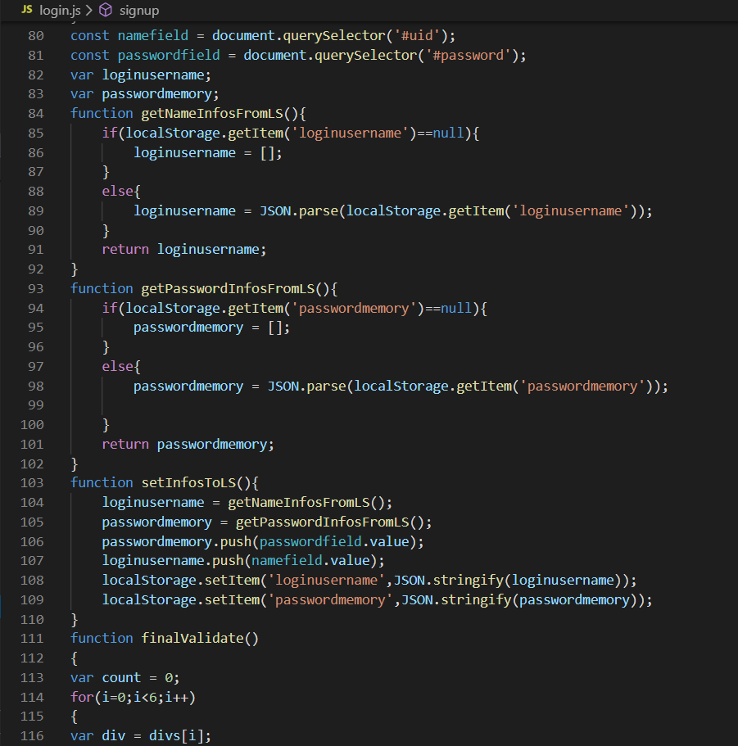
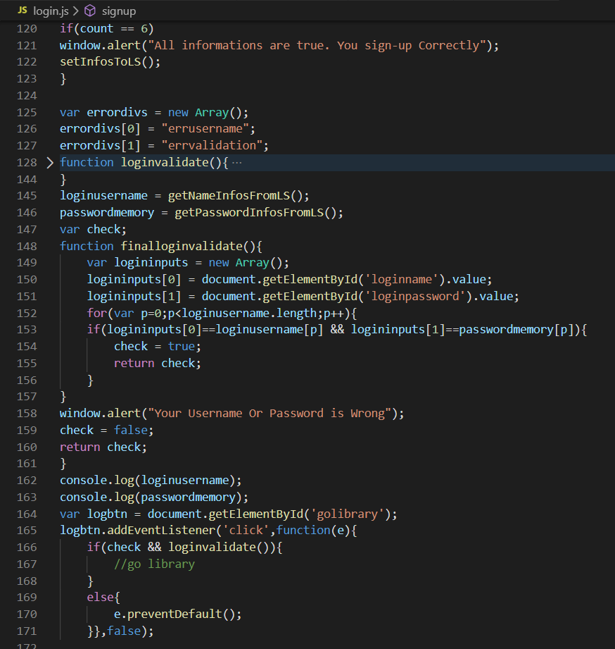
Local Storage Codes

Slide 10
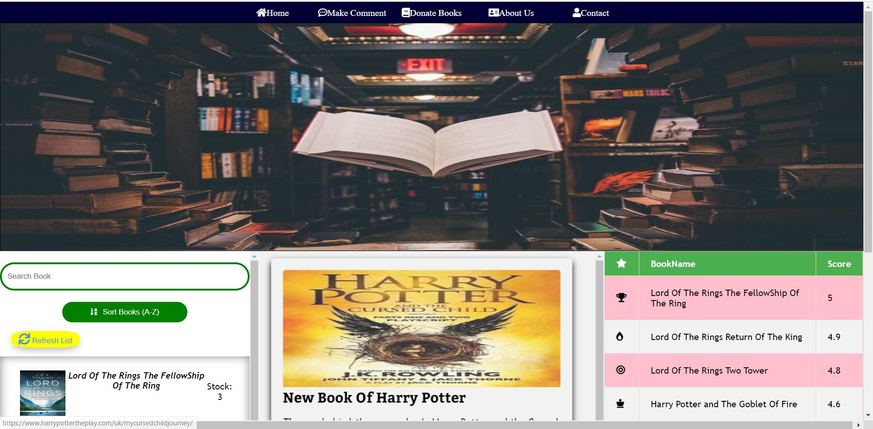
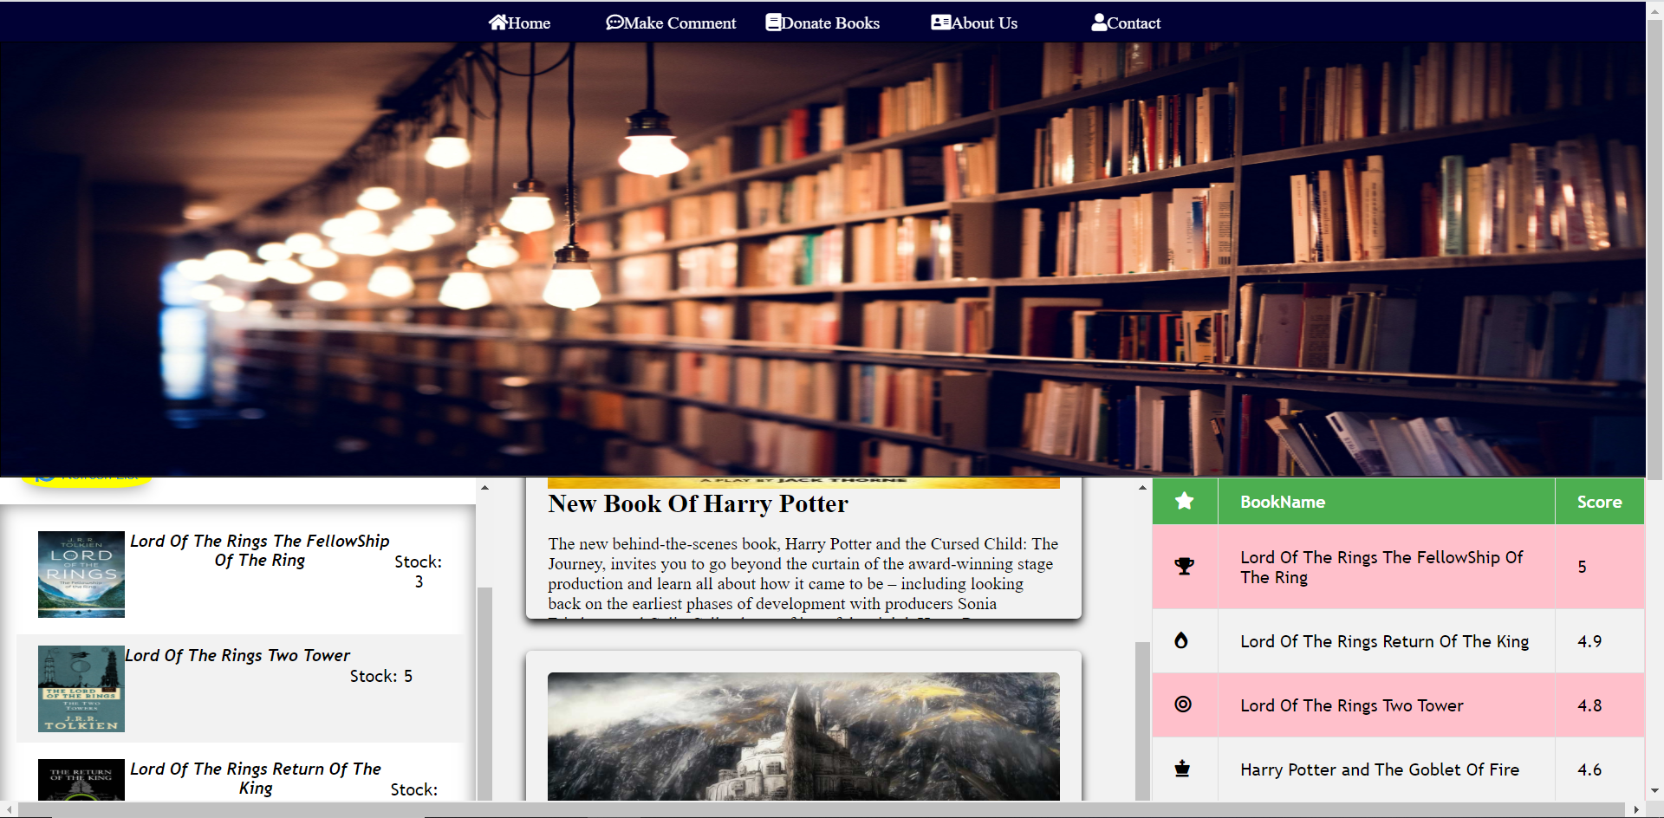
Library Main Page(There is a slider under navigation bar)

Slide 11
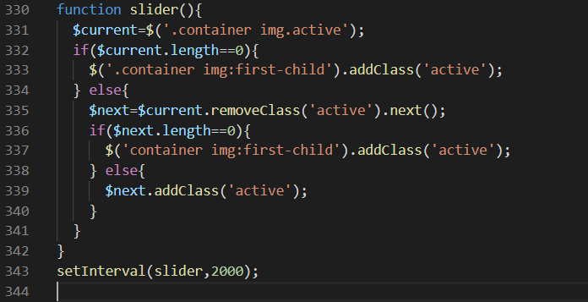

Slide 12
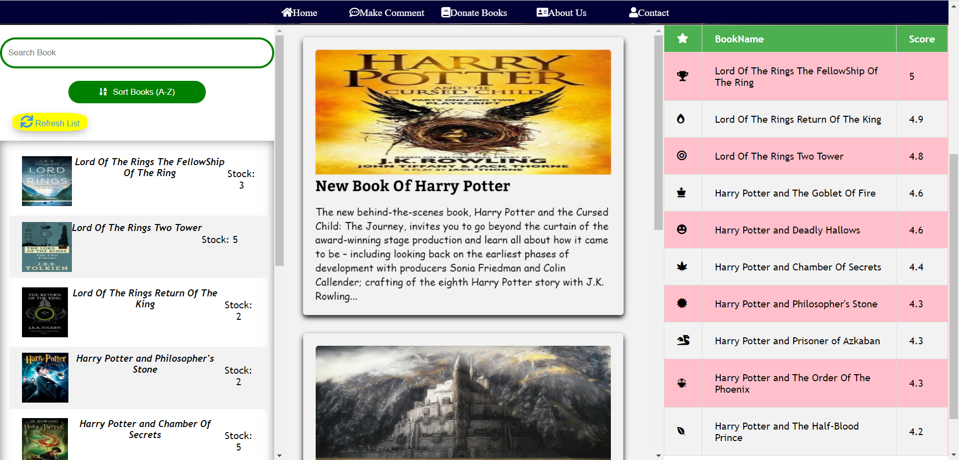
Left Side you can see all the books that inculed in library. In the Middle you can see current news about books. In the Right Side you can see books and score that gives by Professional critics.(Top 10 Books Sorted by Their Score)

Slide 13
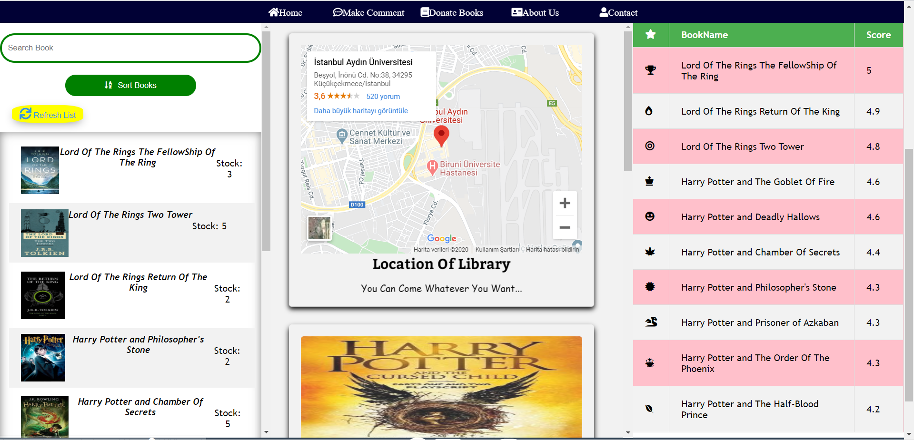
You Can See Google Maps Location In The Middle

Slide 14
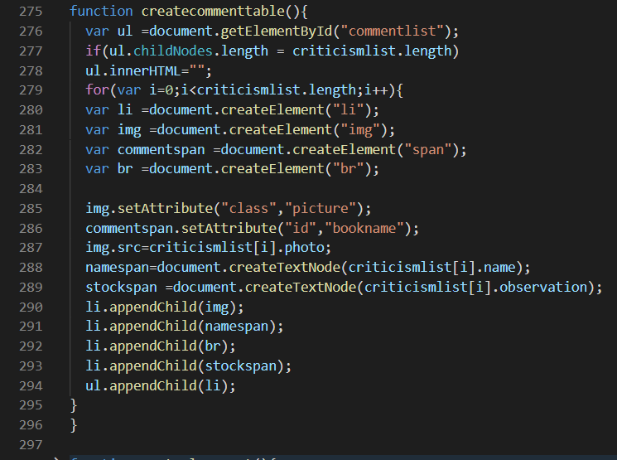
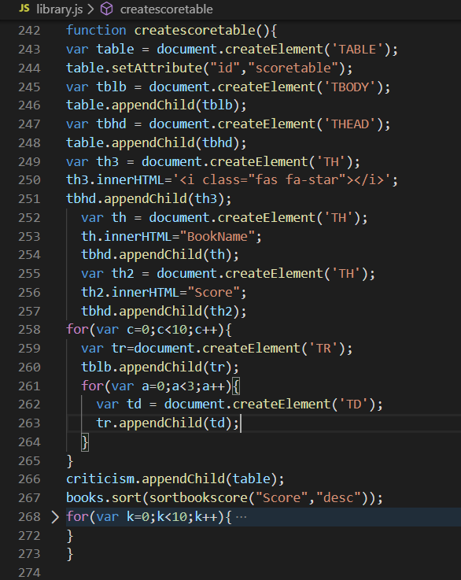
JS CODE
CREATING SCORE TABLE
CREATING COMMENT TABLE

Slide 15
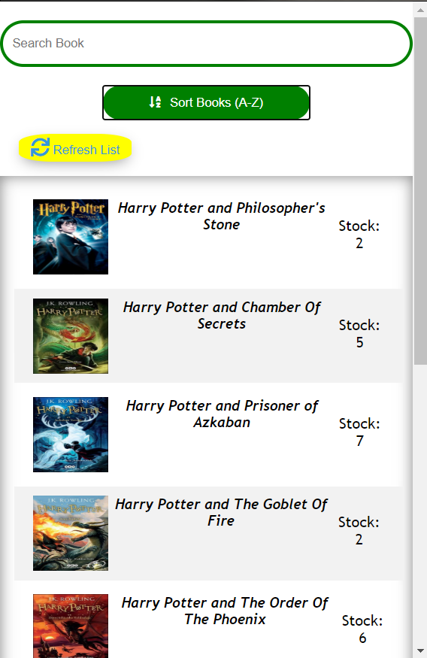
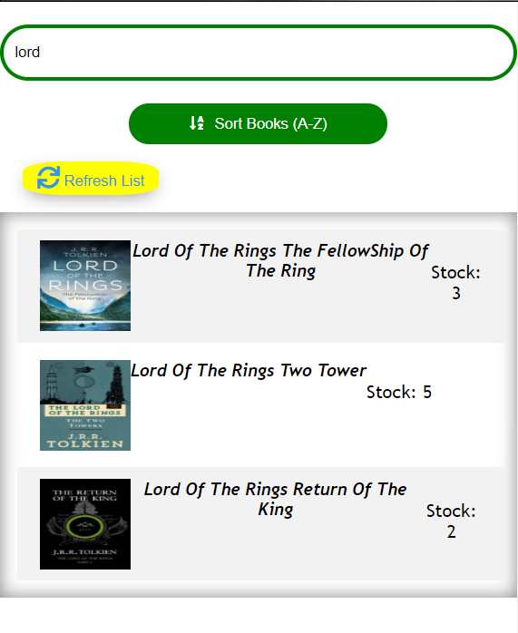
You Can Sort The Books
You Can Search the Books You Want

Slide 16
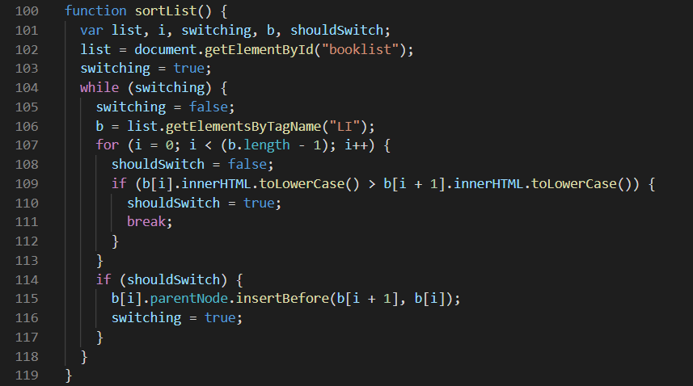
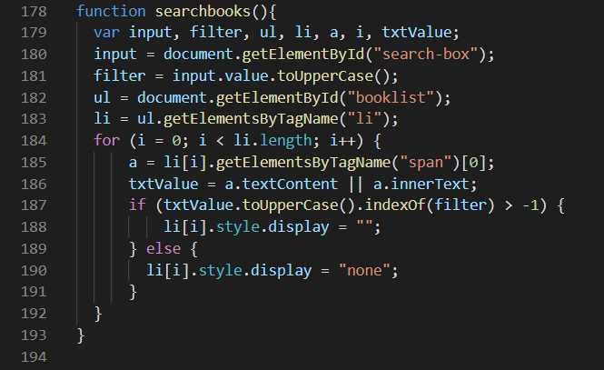
Sort And Search Codes

Slide 17
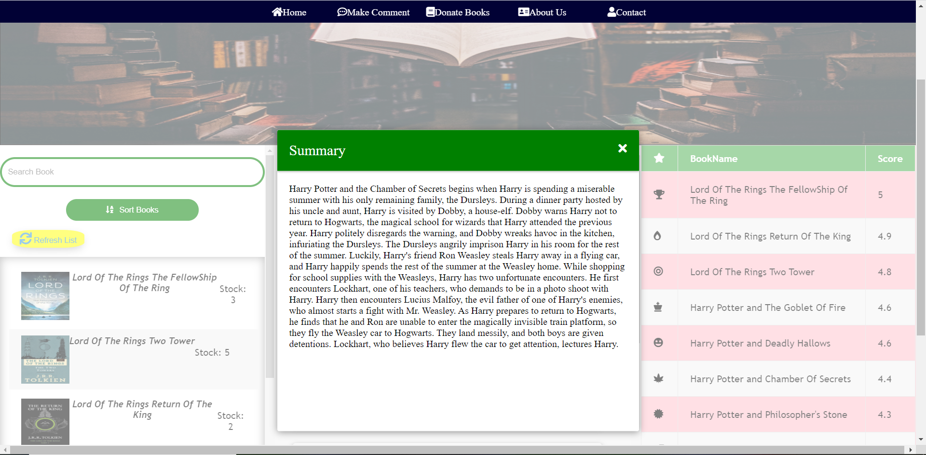
If you click the book, you can read the summary of the book that you choose.

Slide 18
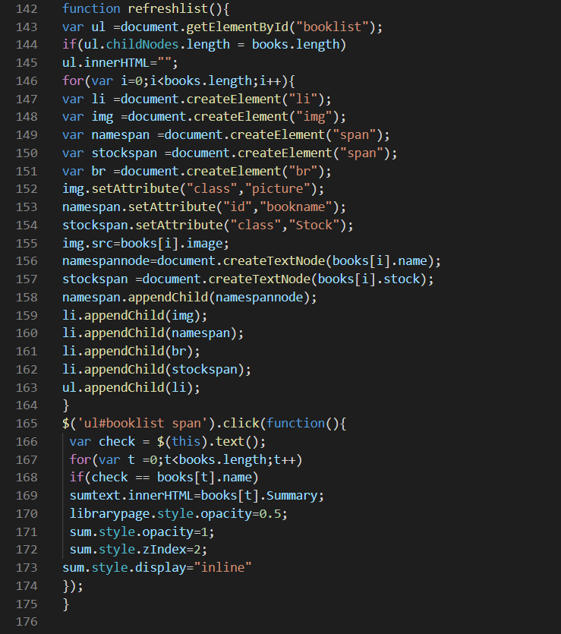
Creating Book List and Modal(Summary)

Slide 19
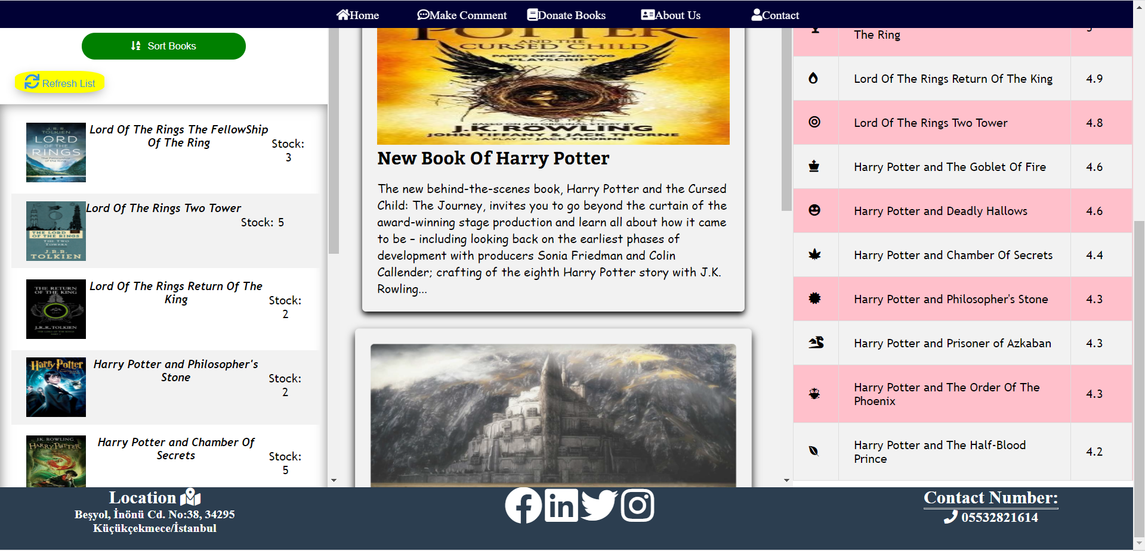

If you click about us(in the navigation bar) system send you to the footer automatically.
Dropdown

Slide 20
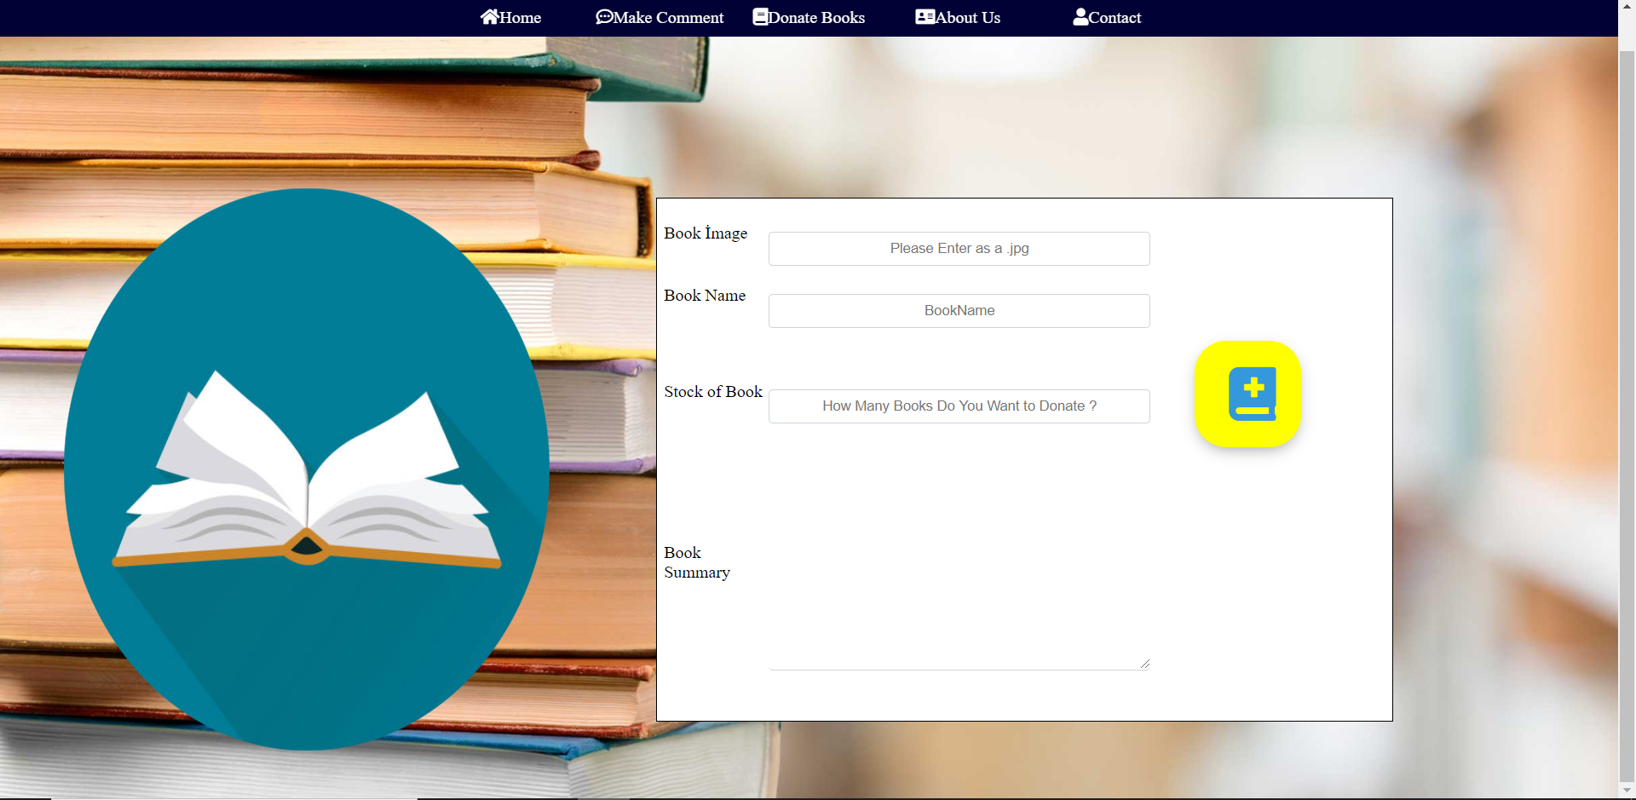
When you click the Donate Books.(In the navigation bar) You can see the Donate Book Page. You Can Donate Book In This Page.

Slide 21
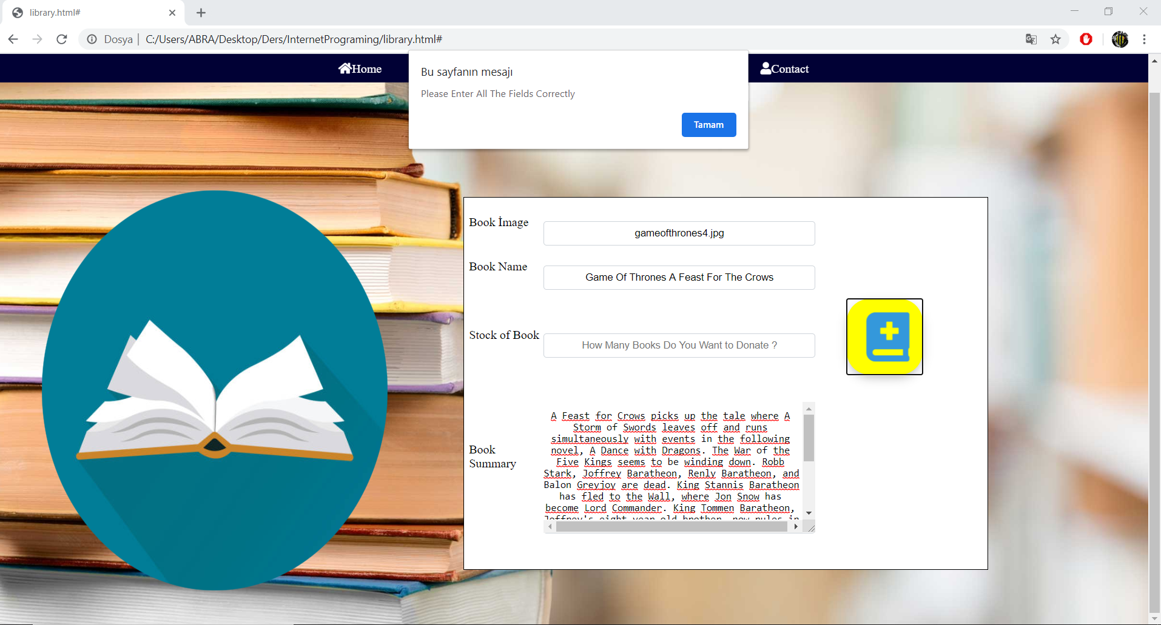

Donate Book Validation Controls

Slide 22
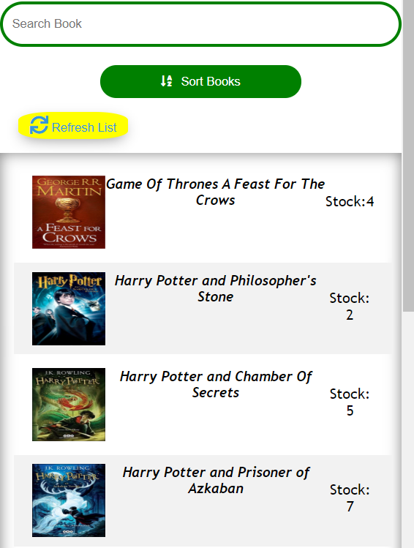
If you refresh list you can see the books you added

Slide 23
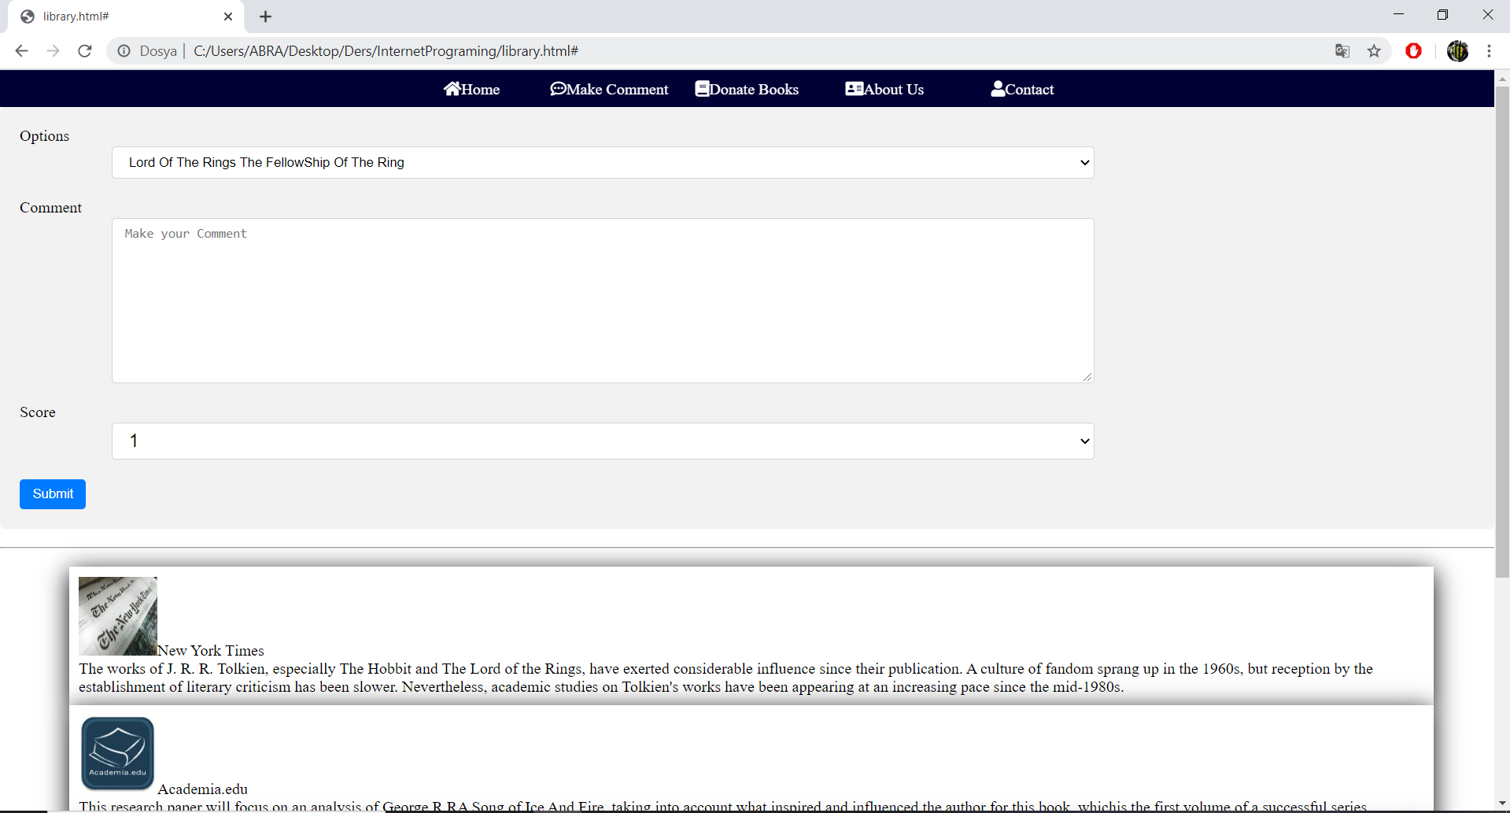
When you click the Make Comment.(In the navigation bar) You can see the Comment Page. You Can Make Comment In This Page and You Can Give Scores to Books You Want.

Slide 24
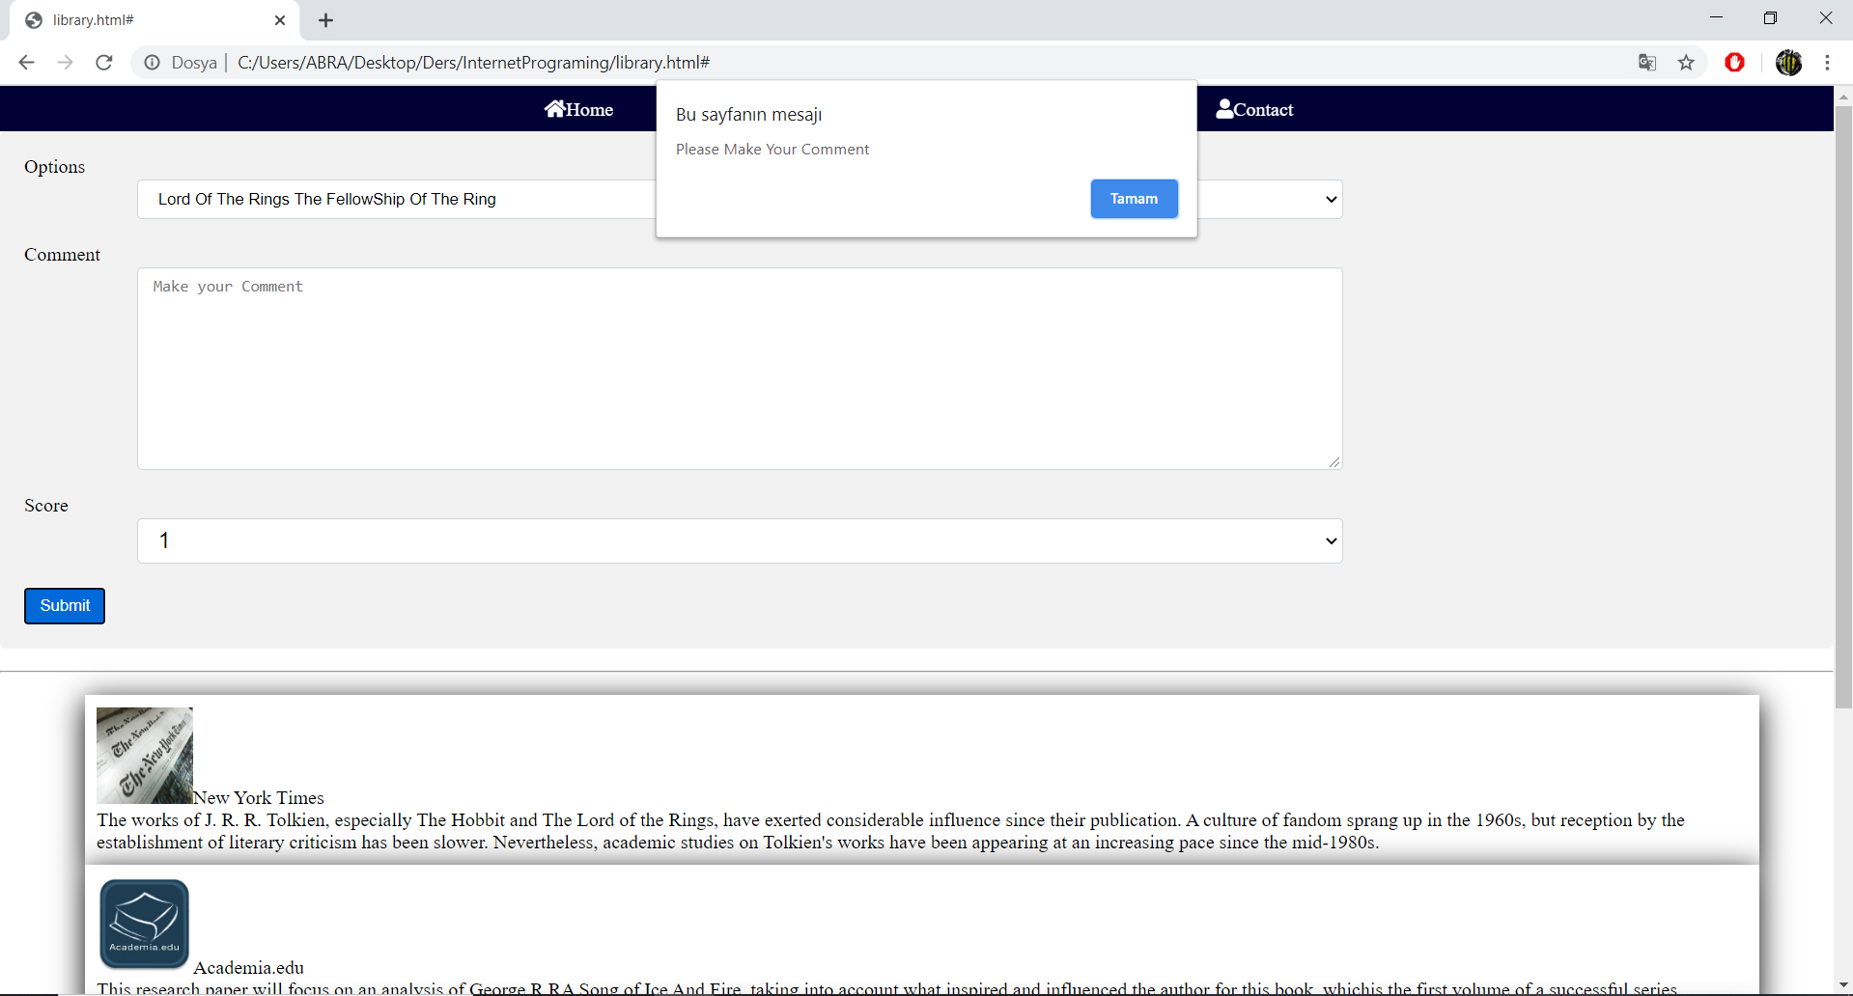
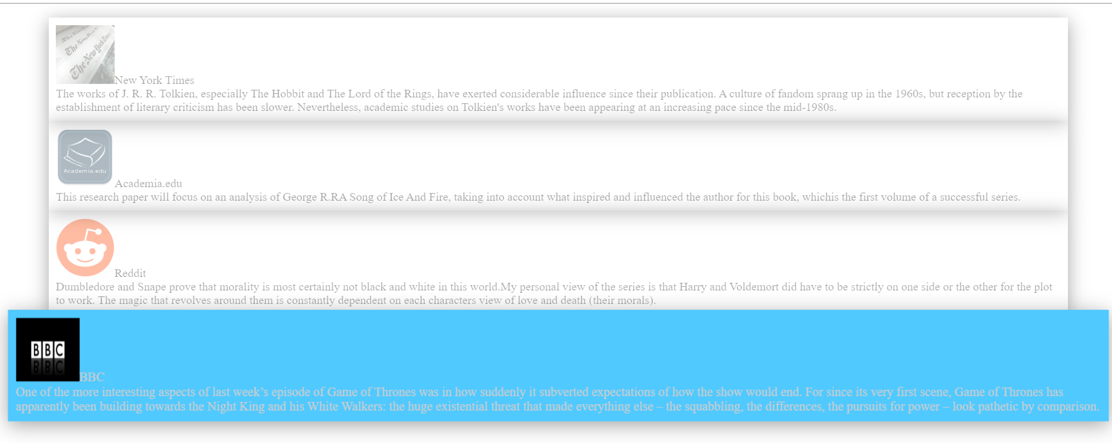
COMMENT VALIDATION CONTROL
CSS

Slide 25
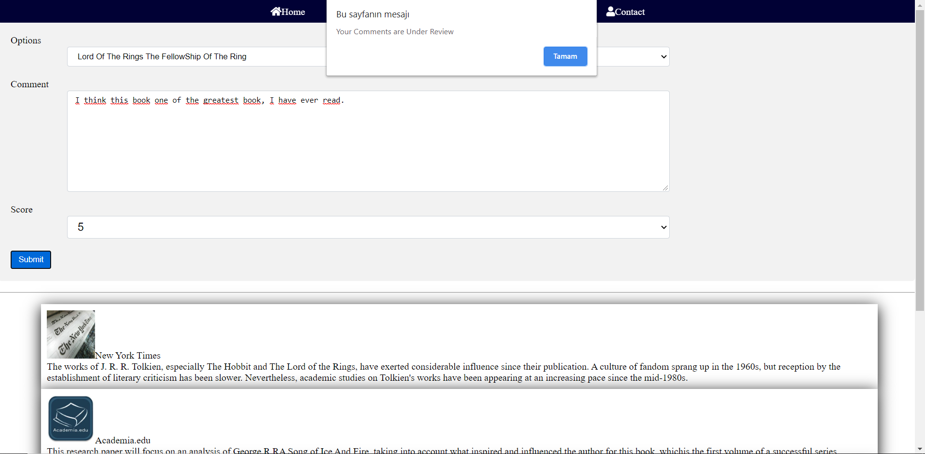
COMMENT VALIDATION CONTROL

Slide 26
NOTES
I couldn't show some css in the photos. Because when I hover the button or card I couldn't take screenshots. But all the lists,tables and buttons have css(when hover the list or table change their box-shadow background image width, height etc.).

